Slide 1
Bayesian
Probability = Belief
Past
Present
Future
Probability = Frequnecy
Frequentist

Slide 2
Start = Prior = Belief
Observation
Bayes Theorem
Updating Beliefs
Posteriri→ New Prior
Bayesian
Updating

Slide 3
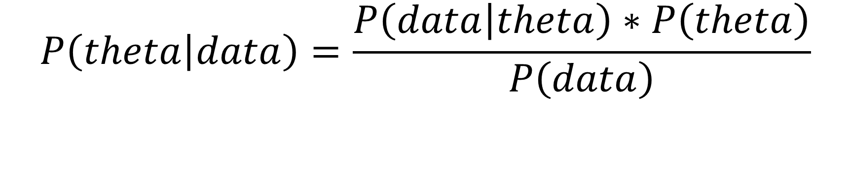
Likelihood of data, given a model
Prior/Belief
a posteriori probability
$$P\left(theta | data\right)=\frac{P\left(data | theta\right)∗P\left(theta\right)}{P\left(data\right)}$$
Probabilty of generating data given a model under all possible theta

Slide 4
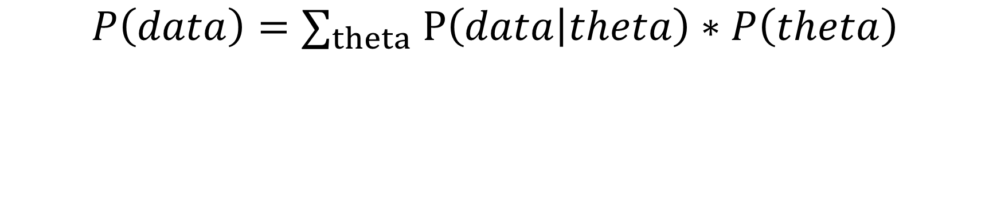
$$P\left(data\right)={\text{∑}}_{theta} P\left(data | theta\right)∗P\left(theta\right)$$

Slide 5
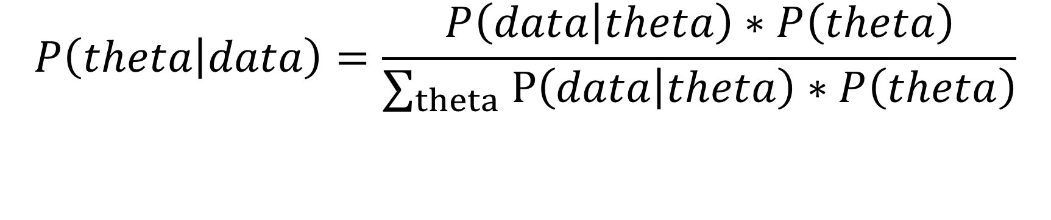
$$P\left(theta | data\right)=\frac{P\left(data | theta\right)∗P\left(theta\right)}{{\text{∑}}_{theta} P\left(data | theta\right)∗P\left(theta\right)}$$

Slide 6
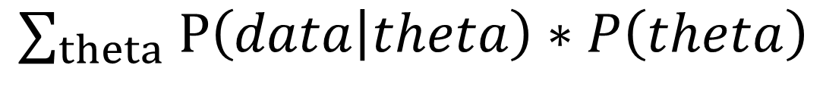
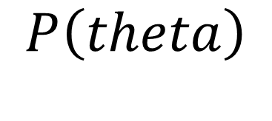
$$P\left(theta\right)$$
$${\text{∑}}_{theta} P\left(data | theta\right)∗P\left(theta\right)$$

